Slide 1
Building the Vehicle Frame
Chris Jones, Chief Race Judge

Slide 2
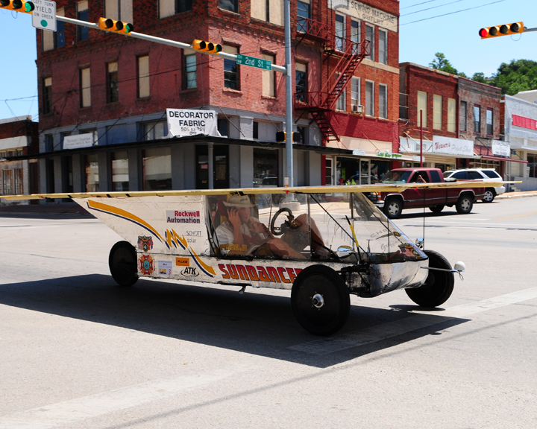
Building the Vehicle Frame
Materials
Safety Cell, Roll bar and Crush Zones
Suspension and Steering
Wheels and Brakes

Slide 3
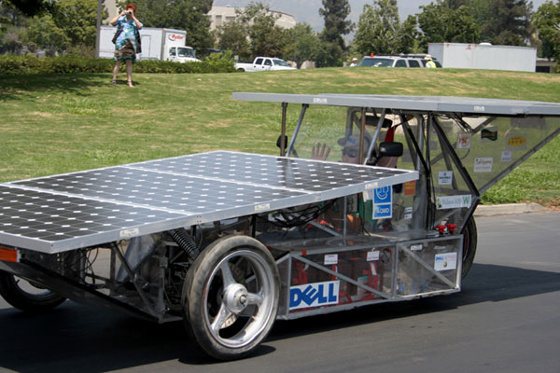
Material for the frame
Mild/Carbon Steel
  Really easy to work with (MIG welding)
  Inexpensive (~$2/foot)
  Heavy
  Can be easily changed/modified
  Readily accessible
  Comes in a large variety of sizes and wall thicknesses

Slide 4
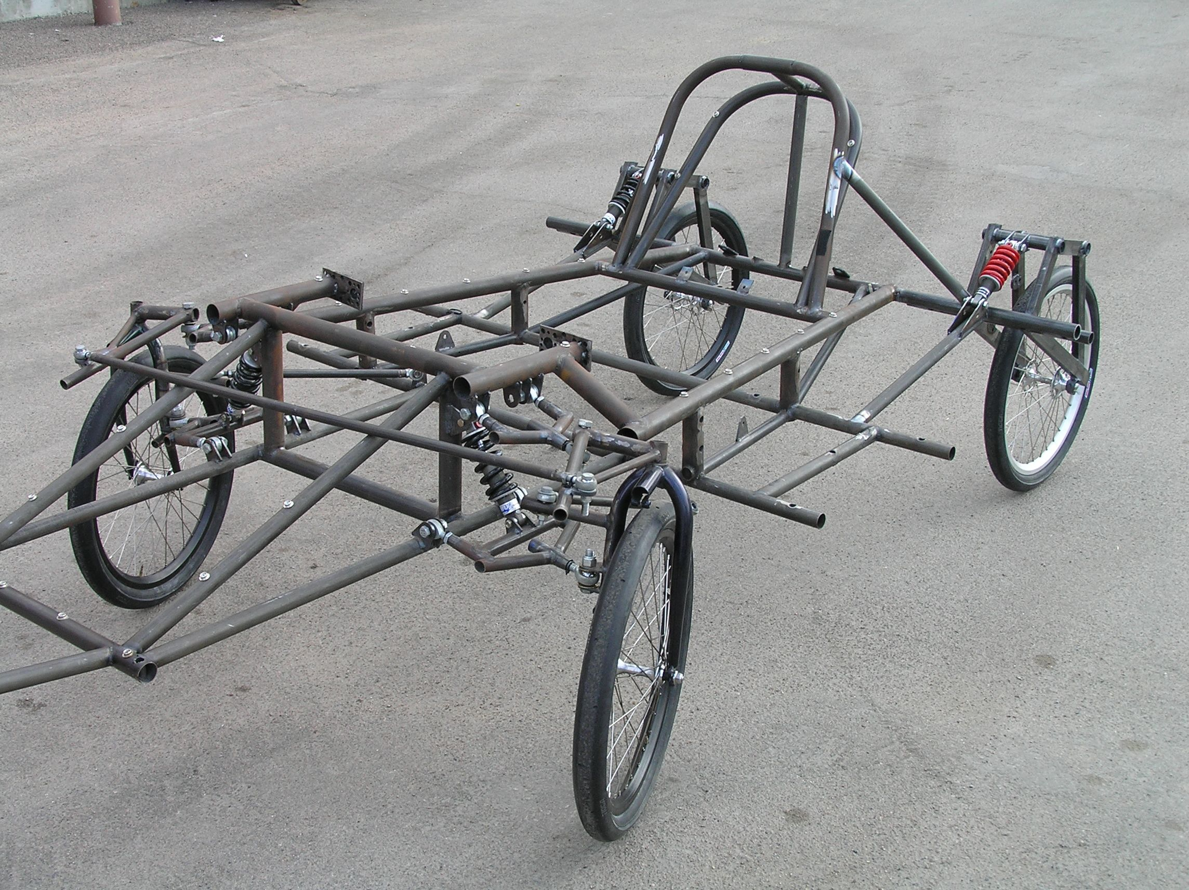
Material for the frame
Chromoly Steel
  More expensive (~$12/foot) (+welding wire @ $15/lb)
  Light weight
  Can be easily changed/modified
  Comes in a large variety of sizes and wall thicknesses

Slide 5
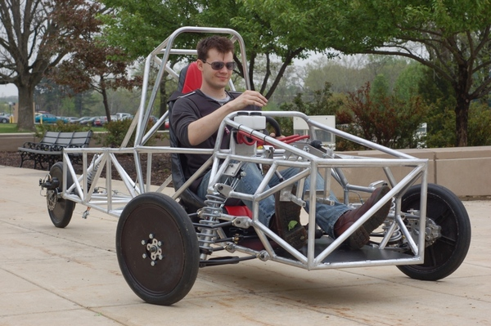
Material for the frame
Aluminum
  Very stiff for its weight
  Harder to weld (TIG)
    MIG is possible, but not wire-fed
  Generally tubular; notch to get better fit
  Needs more material to resist fatigue
  Can be difficult to repair

Slide 6
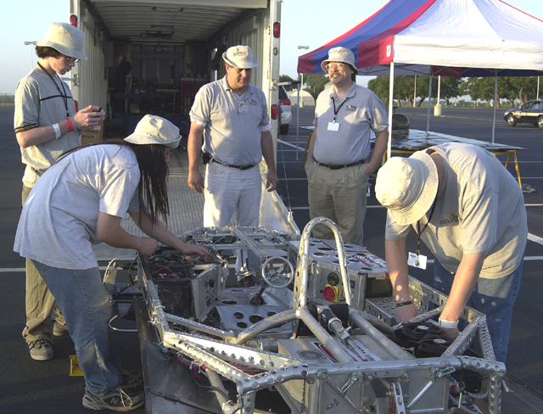
Material for the frame
Titanium
  Light
  Strong (but not stiff)
  Absorbs shock
  Hard to weld
  Expensive
  Limited sizes

Slide 7
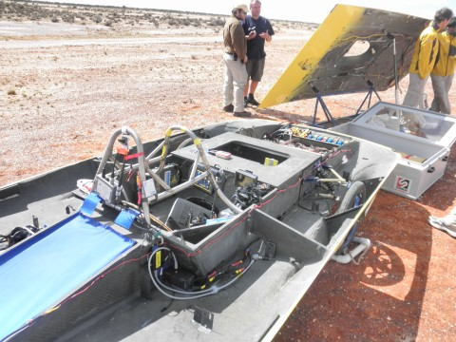
Material for the frame
Carbon Fiber (composites)
  Lightest and stiffest
  Can be formed to any shape
  Expensive
  Needs careful planning
  Learning curve is steep
  Very hard to repair on the side of the road
  Need professional engineer certification if used for safety cell, roll bar, or crush zone

Slide 8
Building the Vehicle Frame
Materials
Safety Cell, Roll bar and Crush Zones
Suspension and Steering
Wheels and Brakes

Slide 9
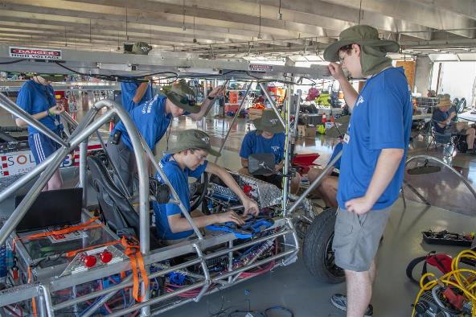
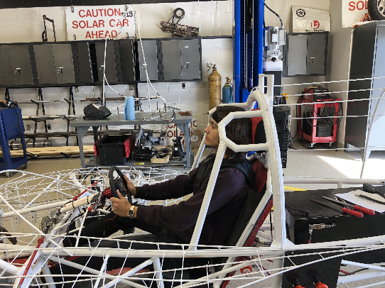
Safety Cell, Crush Zone, Roll Bar
Safety Cell (previously Roll Cage) – rigid protection encompassing entire driver; minimum OD of 1.9cm; minimum 5cm clearance to driver; minimum coverage
Roll Bar – protects driver in event of rollover; continuous piece of metal; minimum 5cm vertical clearance; minimum OD of 5cm; minimum wall thickness based on material; welded to frame
Crush Zone – structural components designed to collapse on impact; minimum 15cm clearance to outside of safety cell; minimum height for left/right crush zone

Slide 10
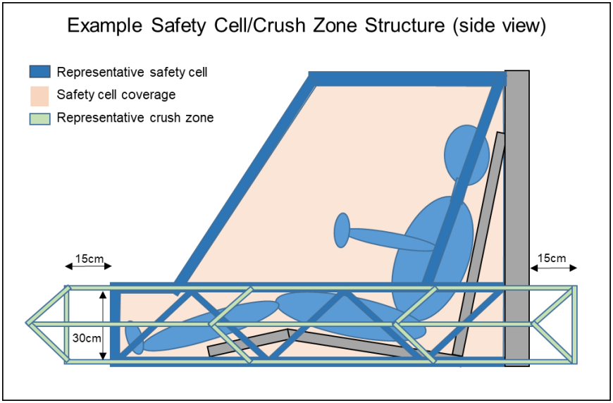
Safety Cell Structure
15cm
Safety Cell encompasses driver’s head, torso, legs, feet
15cm
15cm
Minimum height for left/right side crush zone = 30cm
15cm

Slide 11
Crush Zone
Crush zone must:
  be designed to absorb impact from a collision
  protect the driver from front, side, and rear collisions
  have a minimum of 15 cm of horizontal distance from the outside of the safety cell
Teams must be able to demonstrate a specific, adequate crush zone in order to compete. Insufficient regard for structural safety will result in disqualification.

Slide 12
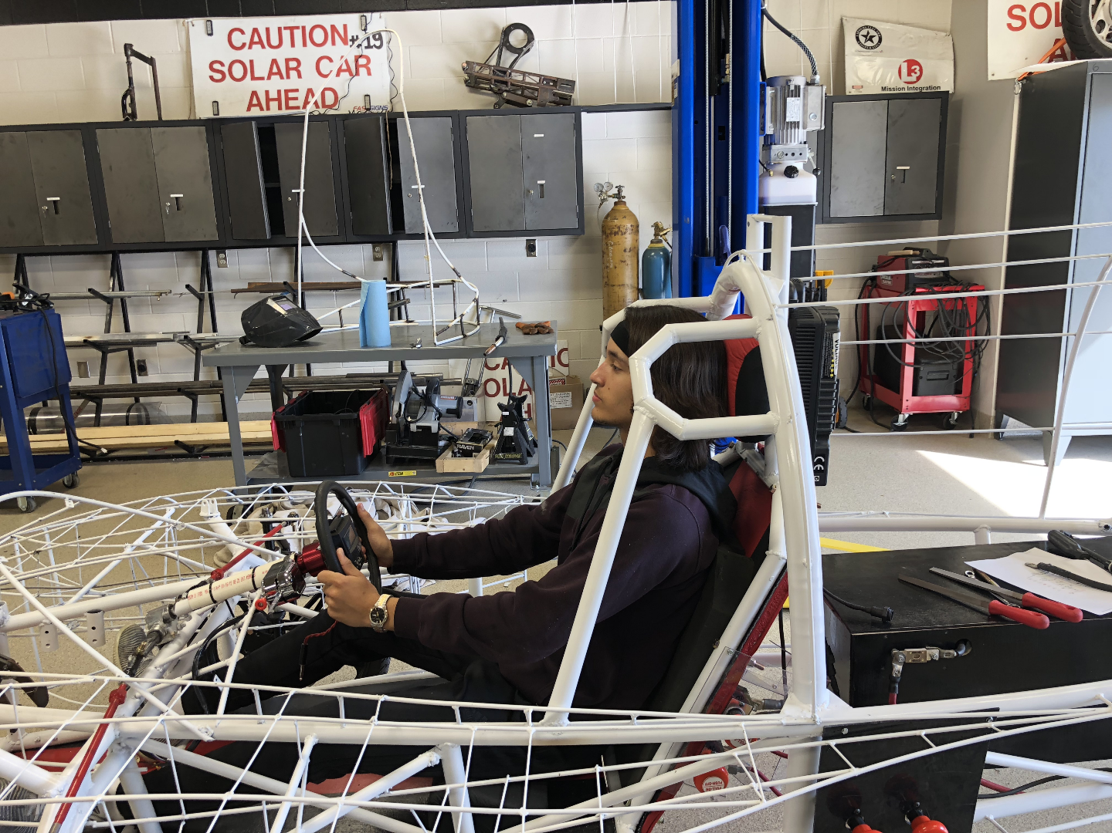
Safety Cell / Roll Bar / Crush Zone
Good Example
Safety Cell Coverage – If wrapped in elastic fabric, no part of driver should touch fabric (other than arms holding steering wheel)
Roll Bar – continuous piece of metal; protects driver in event of rollover
Crush Zone structure – thin material designed to collapse on impact
Safety Cell – rigid protection encompassing entire driver

Slide 13
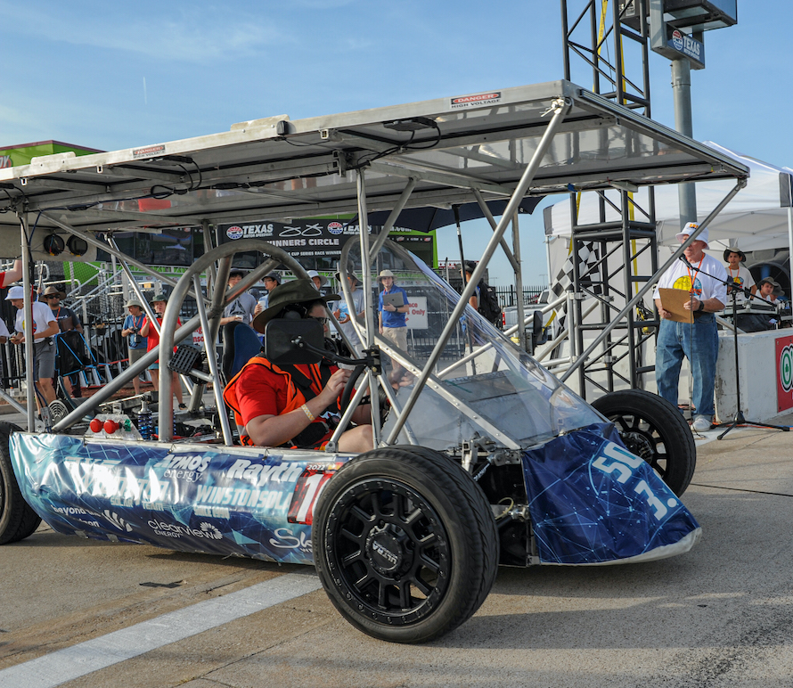
Safety Cell / Roll Bar / Crush Zone Example
Roll Bar – continuous piece of metal; protects driver in event of rollover
Safety Cell – rigid protection encompassing entire driver
Safety Cell Coverage
(in orange)
Crush Zone structure – may not meet 15 cm

Slide 14
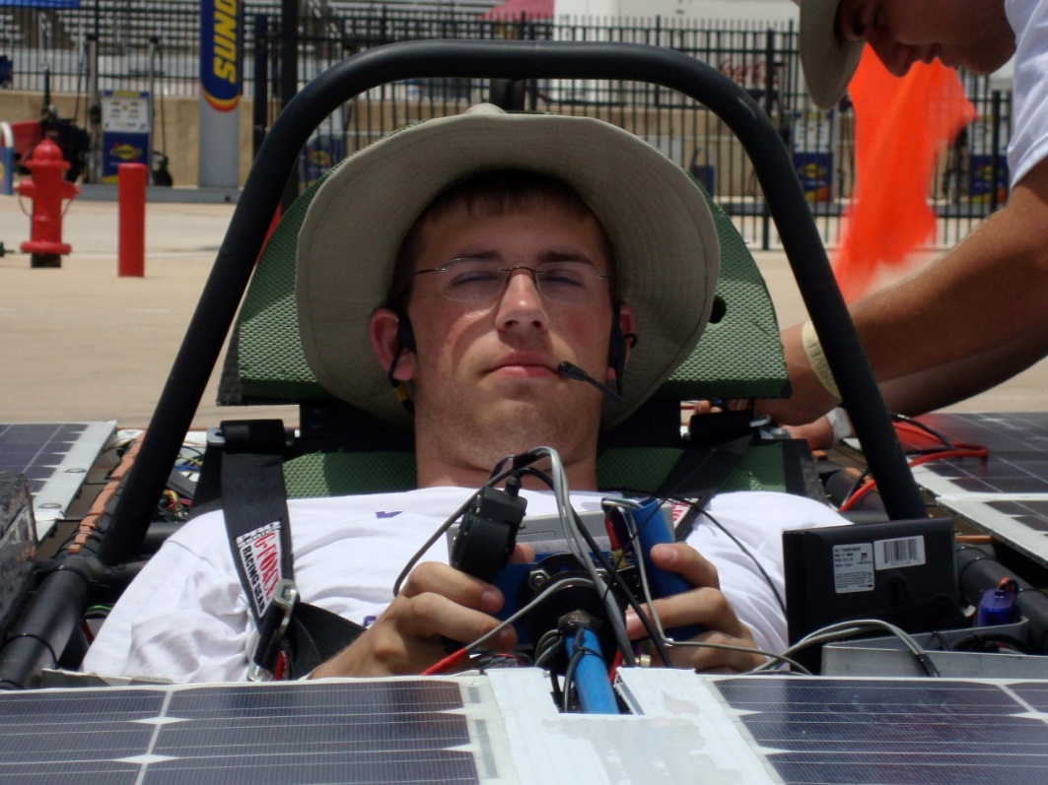
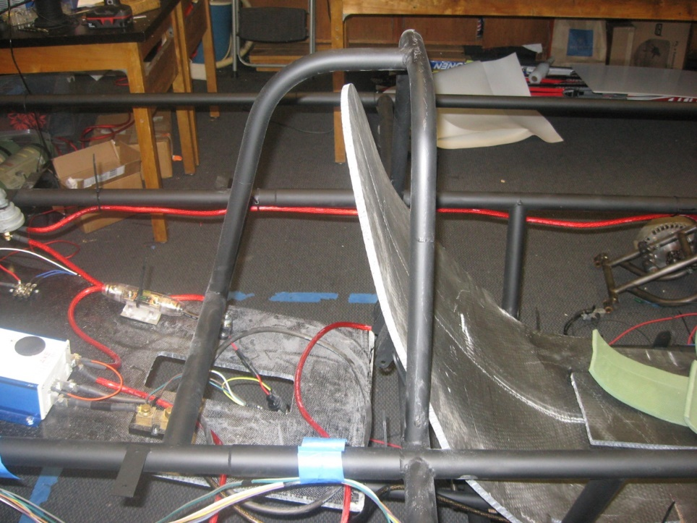
Roll Bar Example
Sufficient vertical clearance
(5 cm between head and
underneath of bar)
Continuous piece of metal
Side View
Front View
Material OD is less that what the rules specify but a waiver was granted
USE THE WAIVER PROCESS (RULE 5.21)

Slide 15
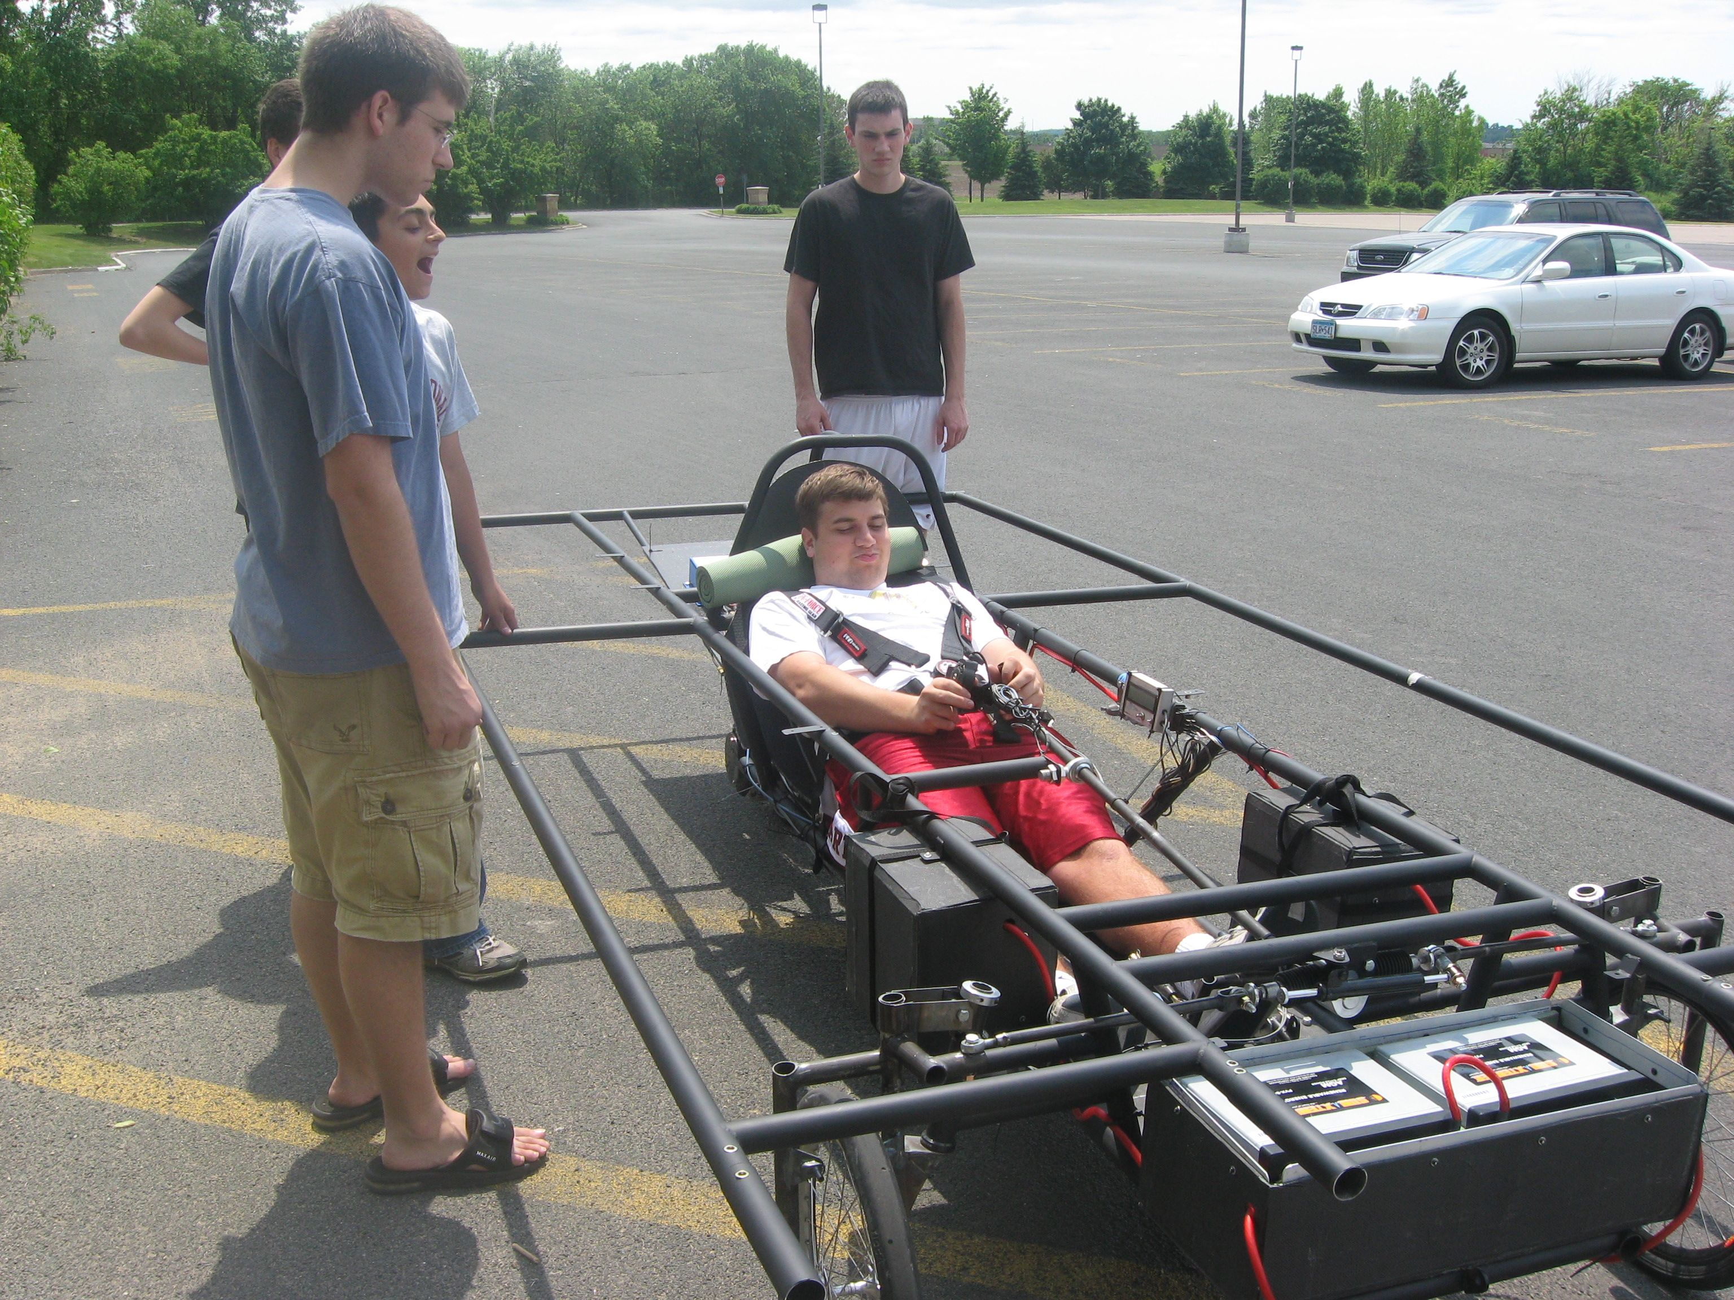
Roll Cage / Crush Zone Example
Crush Zone – would prefer structure less rigid and deflect away from driver
This is one dimensional and would not pass current rules
Safety Cell – good use of strong structural components; needs additional coverage for driver torso

Slide 16
Building the Vehicle Frame
Materials
Safety Cell, Roll bar and Crush Zones
Suspension and Steering
Wheels and Brakes

Slide 17
Suspension Design
Agenda
Purpose of Suspension
Suspension components
Types of Suspension
Basic Suspension Geometry
Steering Geometry

Slide 18
Suspension Purpose
Minimize shock to the driver and the car
Enhance car stability while traveling on dynamic terrain
  Keep the Tires on the Ground
  Seriously, Your tires are the only connection the car has to the ground

Slide 19
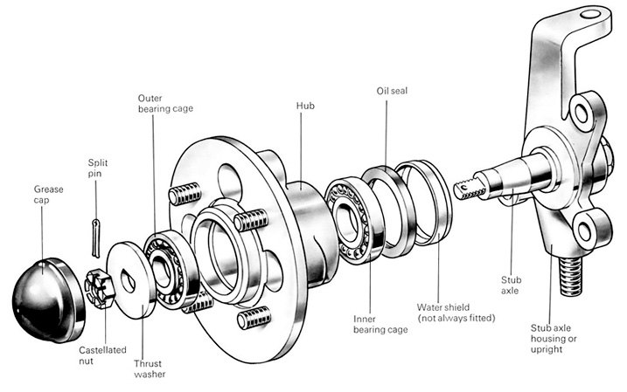
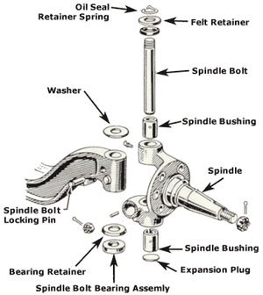
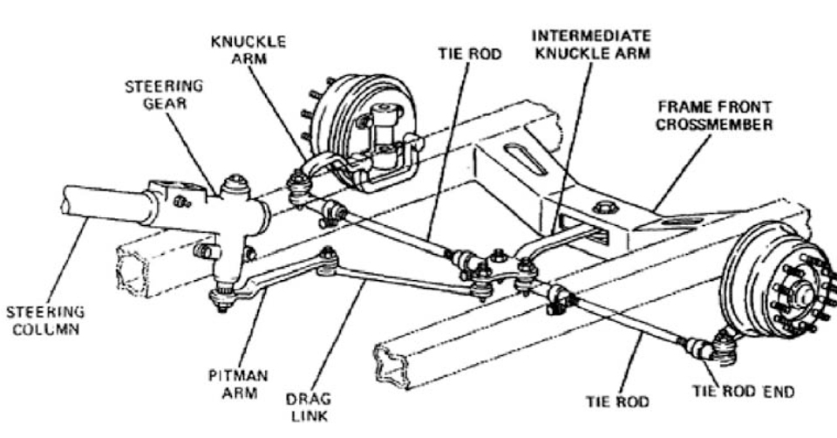
Suspension Components
Hub
Spindle
Axle
Tie Rod

Slide 20
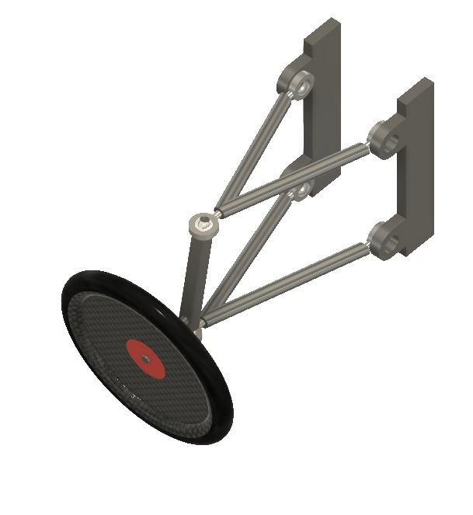
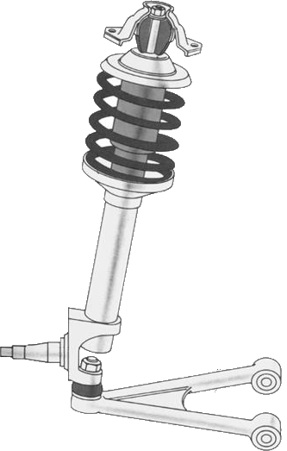

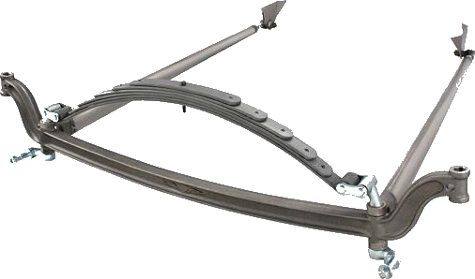
Common Front Suspension Types
MacPherson Strut
Solid Axle
Dual A Arm
Notes:
MacPherson
-production vehicles
-tend to be heavy
-limited adjustability
Solid Axles
-simple
-geometry is set at construction
-can be heavy
Double Arm
-most popular
-very versatile
-can be complicated with lots of options and area for mistakes

Slide 21
Common Front Suspension Types
 | Macpherson | Solid Axle | Double Wishbone (Dual A-Arm) | No Suspension
Pros | Less Components Easier to build | Simple Inexpensive Easy to manufacture | Versatile Most popular (Easy to find parts) Most Adjustability | Less weight Less components Easy to make
Cons | Limited Adjustability Heavy Undesirable Handling | Heavy Poor ride quality | Complicated (lots of areas to make mistakes) Difficult to manufacture | Rough on other components Require Strong Chassis(& Driver) Will fail on road race

Slide 22
Some Tips about Suspension
Lets pause for a second…
Suspension Can be very complex
  Don’t Fall into the rabbit hole!
  Design for Strength
  Design for Adjustability if possible

Slide 23
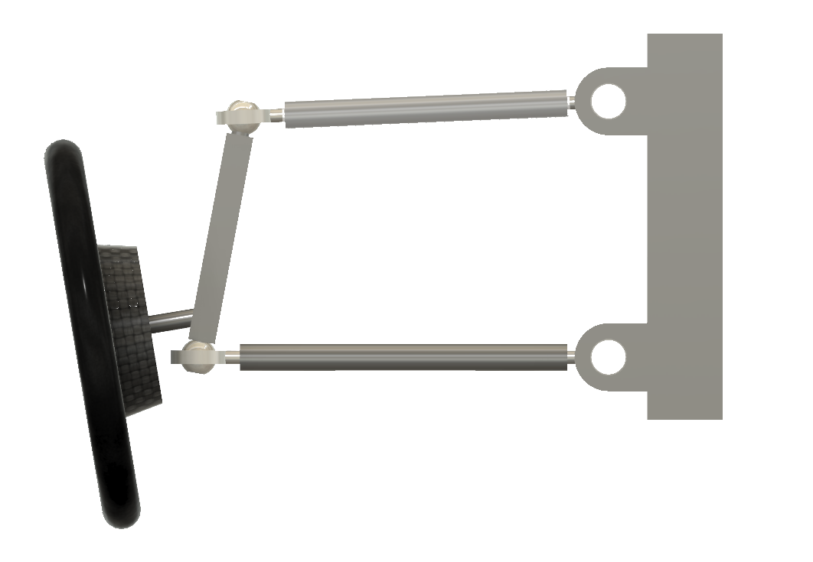
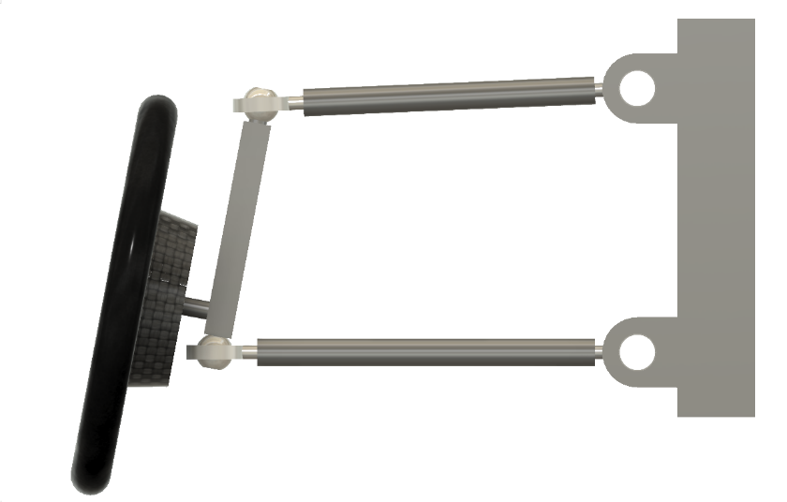


Suspension Geometry
Rear/Front View
  Camber
Vertical
Vertical
$$∅$$
$$∅$$
Front
Negative
Positive
Affects grip and stability in cornering
Not applicable to solar car racing

Slide 24
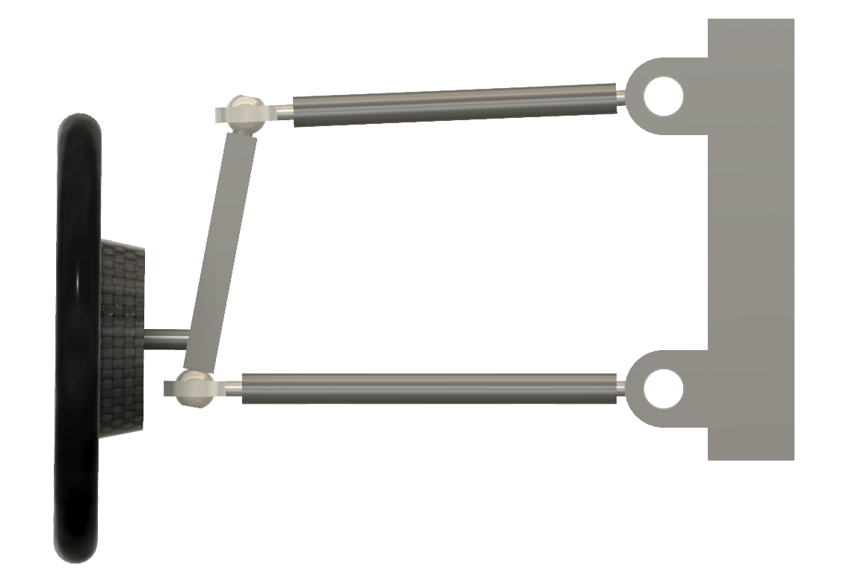
Scrub Radius
Harder to Turn
Increase wear on tire
Positive
    Cause center seeking
Positive
Scrub Radius
Notes:
How much force/wear for turning
Coffee cup experiment – turn cup by turning on a point vs. turning using the handle
Minimize the scrub radius to lessen energy

Slide 25
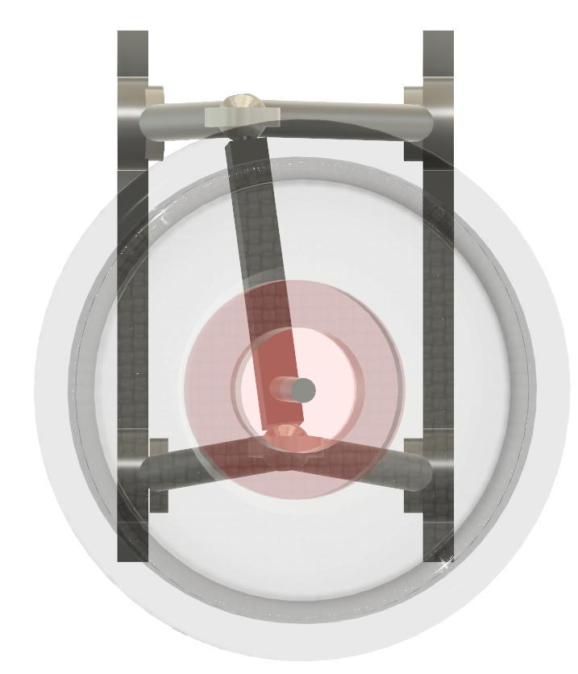
Caster (Side view)
Vertical
Creates straight line stability
Positive Caster
  Steering wheel feedback
  Makes car harder to turn
  Causes wheels to self center
Negative Caster
  Unstable
θ
Front
Positive
Notes:
No correct answer; need to set it up for the driver

Slide 26
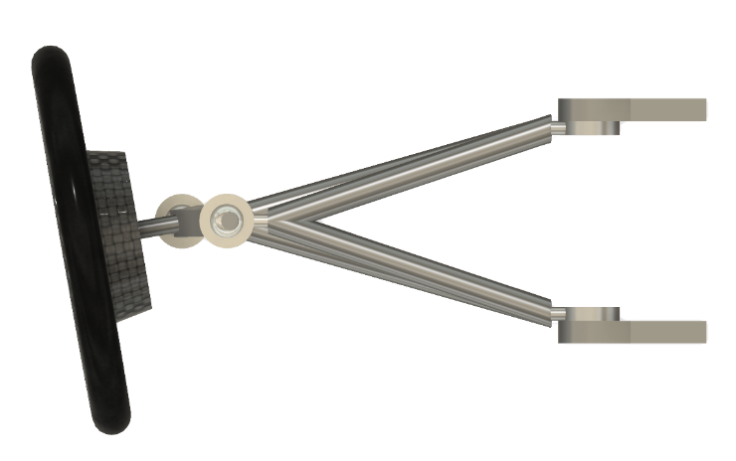
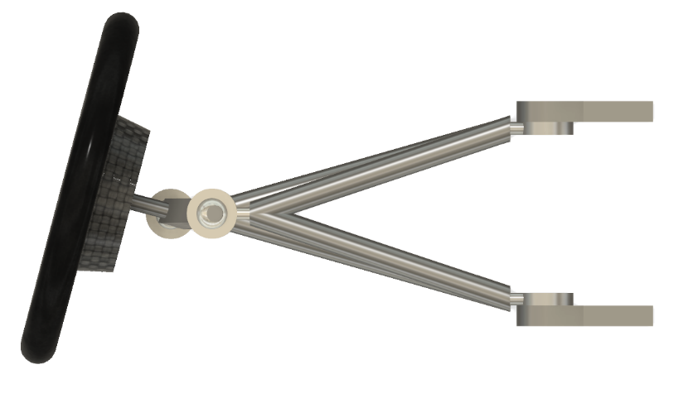
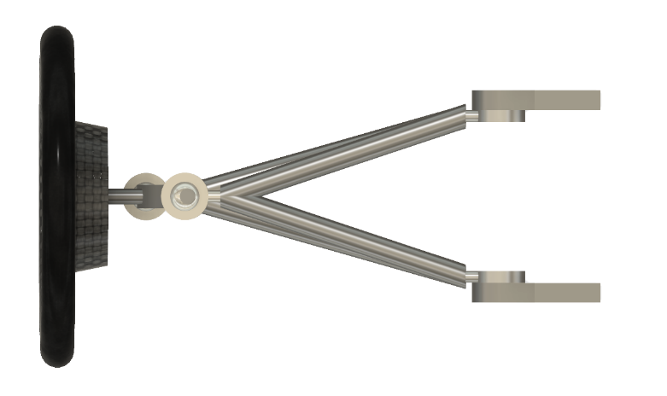


Toe Geometry (Top View)
Center Line
Center Line
$$∅$$
Front
$$∅$$
Center Line
Neutral
In
Improves straight line stability
Out
Improves Steering Response
Can make steering “jerky”
Notes:
Toe
Affects Tire Wear: want to run straight down the road – if in/out, will drag
Solar cars – affected by use of thin tires (Bridgestone Ecopia)

Slide 27


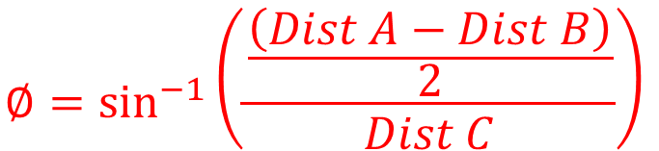
Measuring Toe
Front
$$∅=\sin^{−1}\left(\frac{\frac{\left(Dist A−Dist B\right)}{2}}{Dist C}\right)$$
Dist A
A2
A1
$$Toe=\left(Dist A−Dist B\right)$$
Dist B
C
B1
B2
Notes:
How to do proper alignment
Measure at the same spot each time

Slide 28
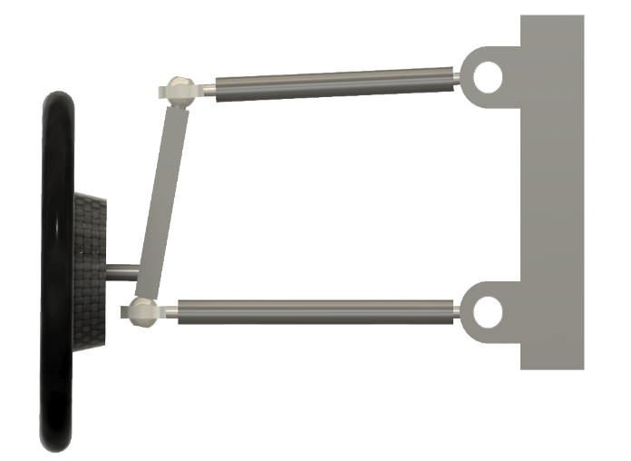
Suspension/Steering Considerations
Steering Axis
  Line between two pivot points of the wheel

Slide 29
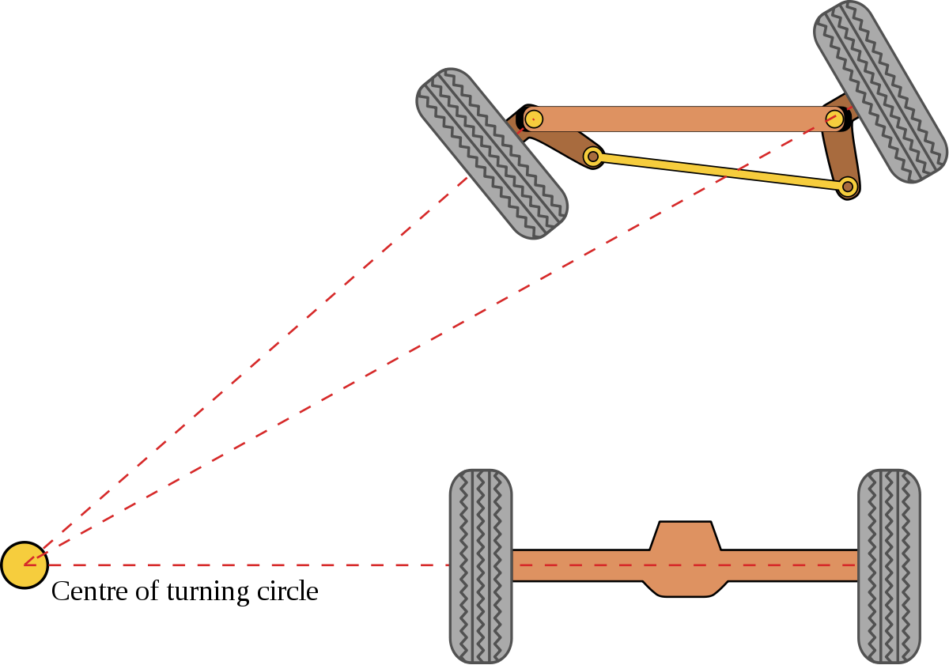
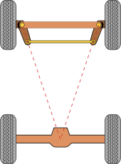
Ackerman Steering

Slide 30
Getting your car rolling
Building the Vehicle Frame
  Materials
  Safety Cell, Roll bar and Crush Zones
  Suspension and Steering
  Wheels and Brakes

Slide 31
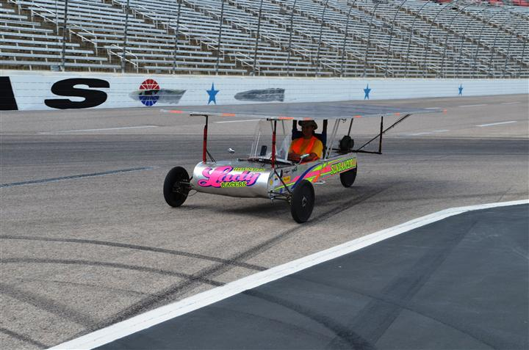
Wheels
One of the most difficult parts to source
Choices need to be made very early in the design process
Three wheel designs:
  Lighter
  Easier to align
  Less expensive
  Not as safe

Slide 32
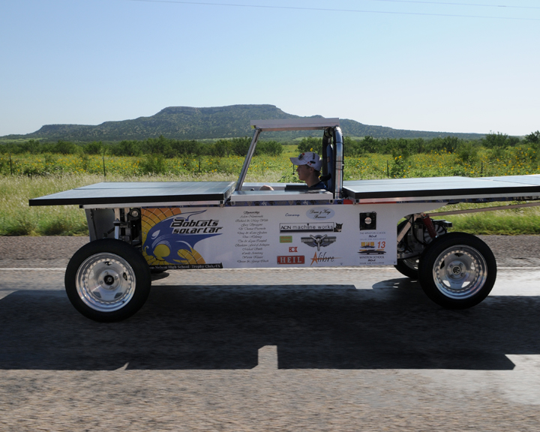
Wheels
Four wheel designs
  More parts means higher cost
  Harder to get alignment correct
  Weight distribution less critical
  Much safer in the event of a flat
  Can “straddle” dead animals on the road
Required for Cruiser Division

Slide 33
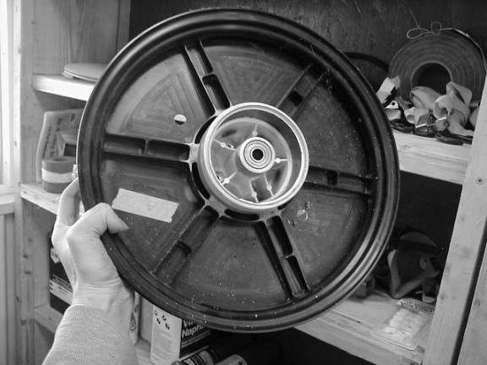
Wheels
Wheel choices (must be able to handle the weight of the car and lateral forces from turning)
  NGM wheels and tires
  Motorcycle
  Junior Dragster
  Bicycle

Slide 34
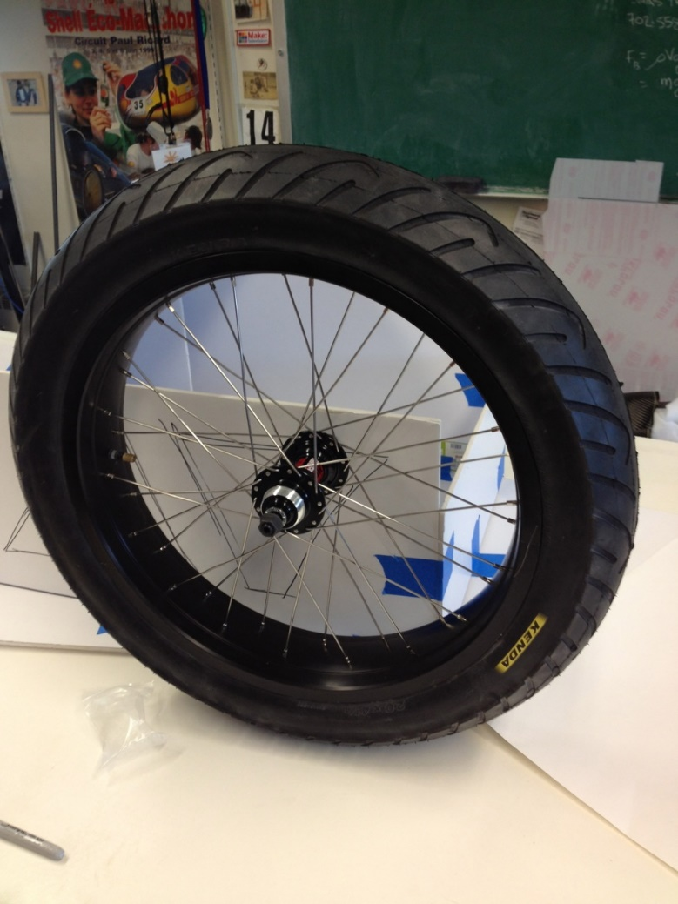
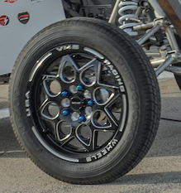
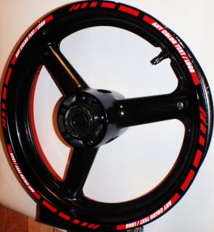
Wheels
Motorcycle
Jr Dragster
Jr Dragster

Slide 35
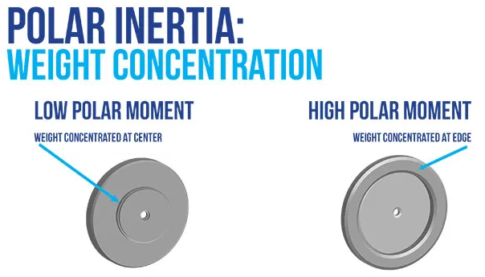
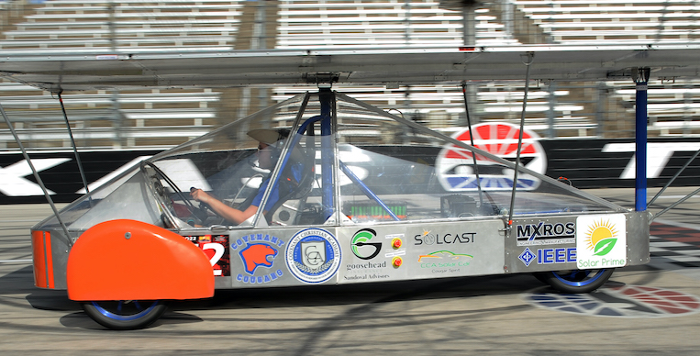
Wheel Considerations
Weight
  High Polar Inertia designs have potential for increased energy consumption
    Extreme example is a flywheel
  Affected by acceleration
Solid vs. Spokes
  Solid = better aerodynamics, may weigh more
  Spokes = worse aerodynamics, less load capacity
  Can be improved by wheel fairings

Slide 36
Tire Considerations
Tire Width
  Thinner = less rolling resistance
  Thicker = supports more weight and more stable on road
Contact patch
  Minimize Contact patch = Minimize Energy loss (less rolling resistance)
  Tire deforms where it contacts the road
Side
Patch
Side
Patch
Ideal
Real

Slide 37
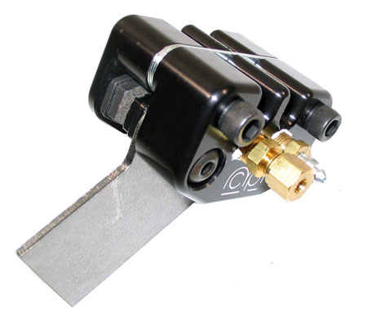
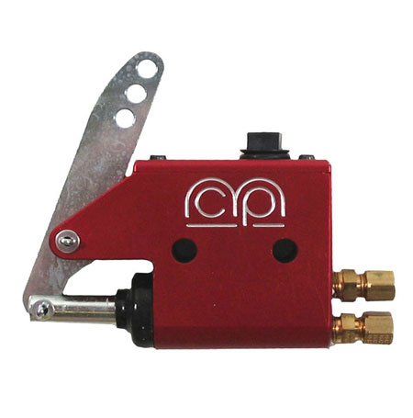
Brakes
Solar car must have two, independent, braking systems that allow the driver to stop the vehicle safely and quickly.
  Most cars use hydraulic disk brakes
  MCP single caliper brakes are easy to install and relatively inexpensive.

Slide 38
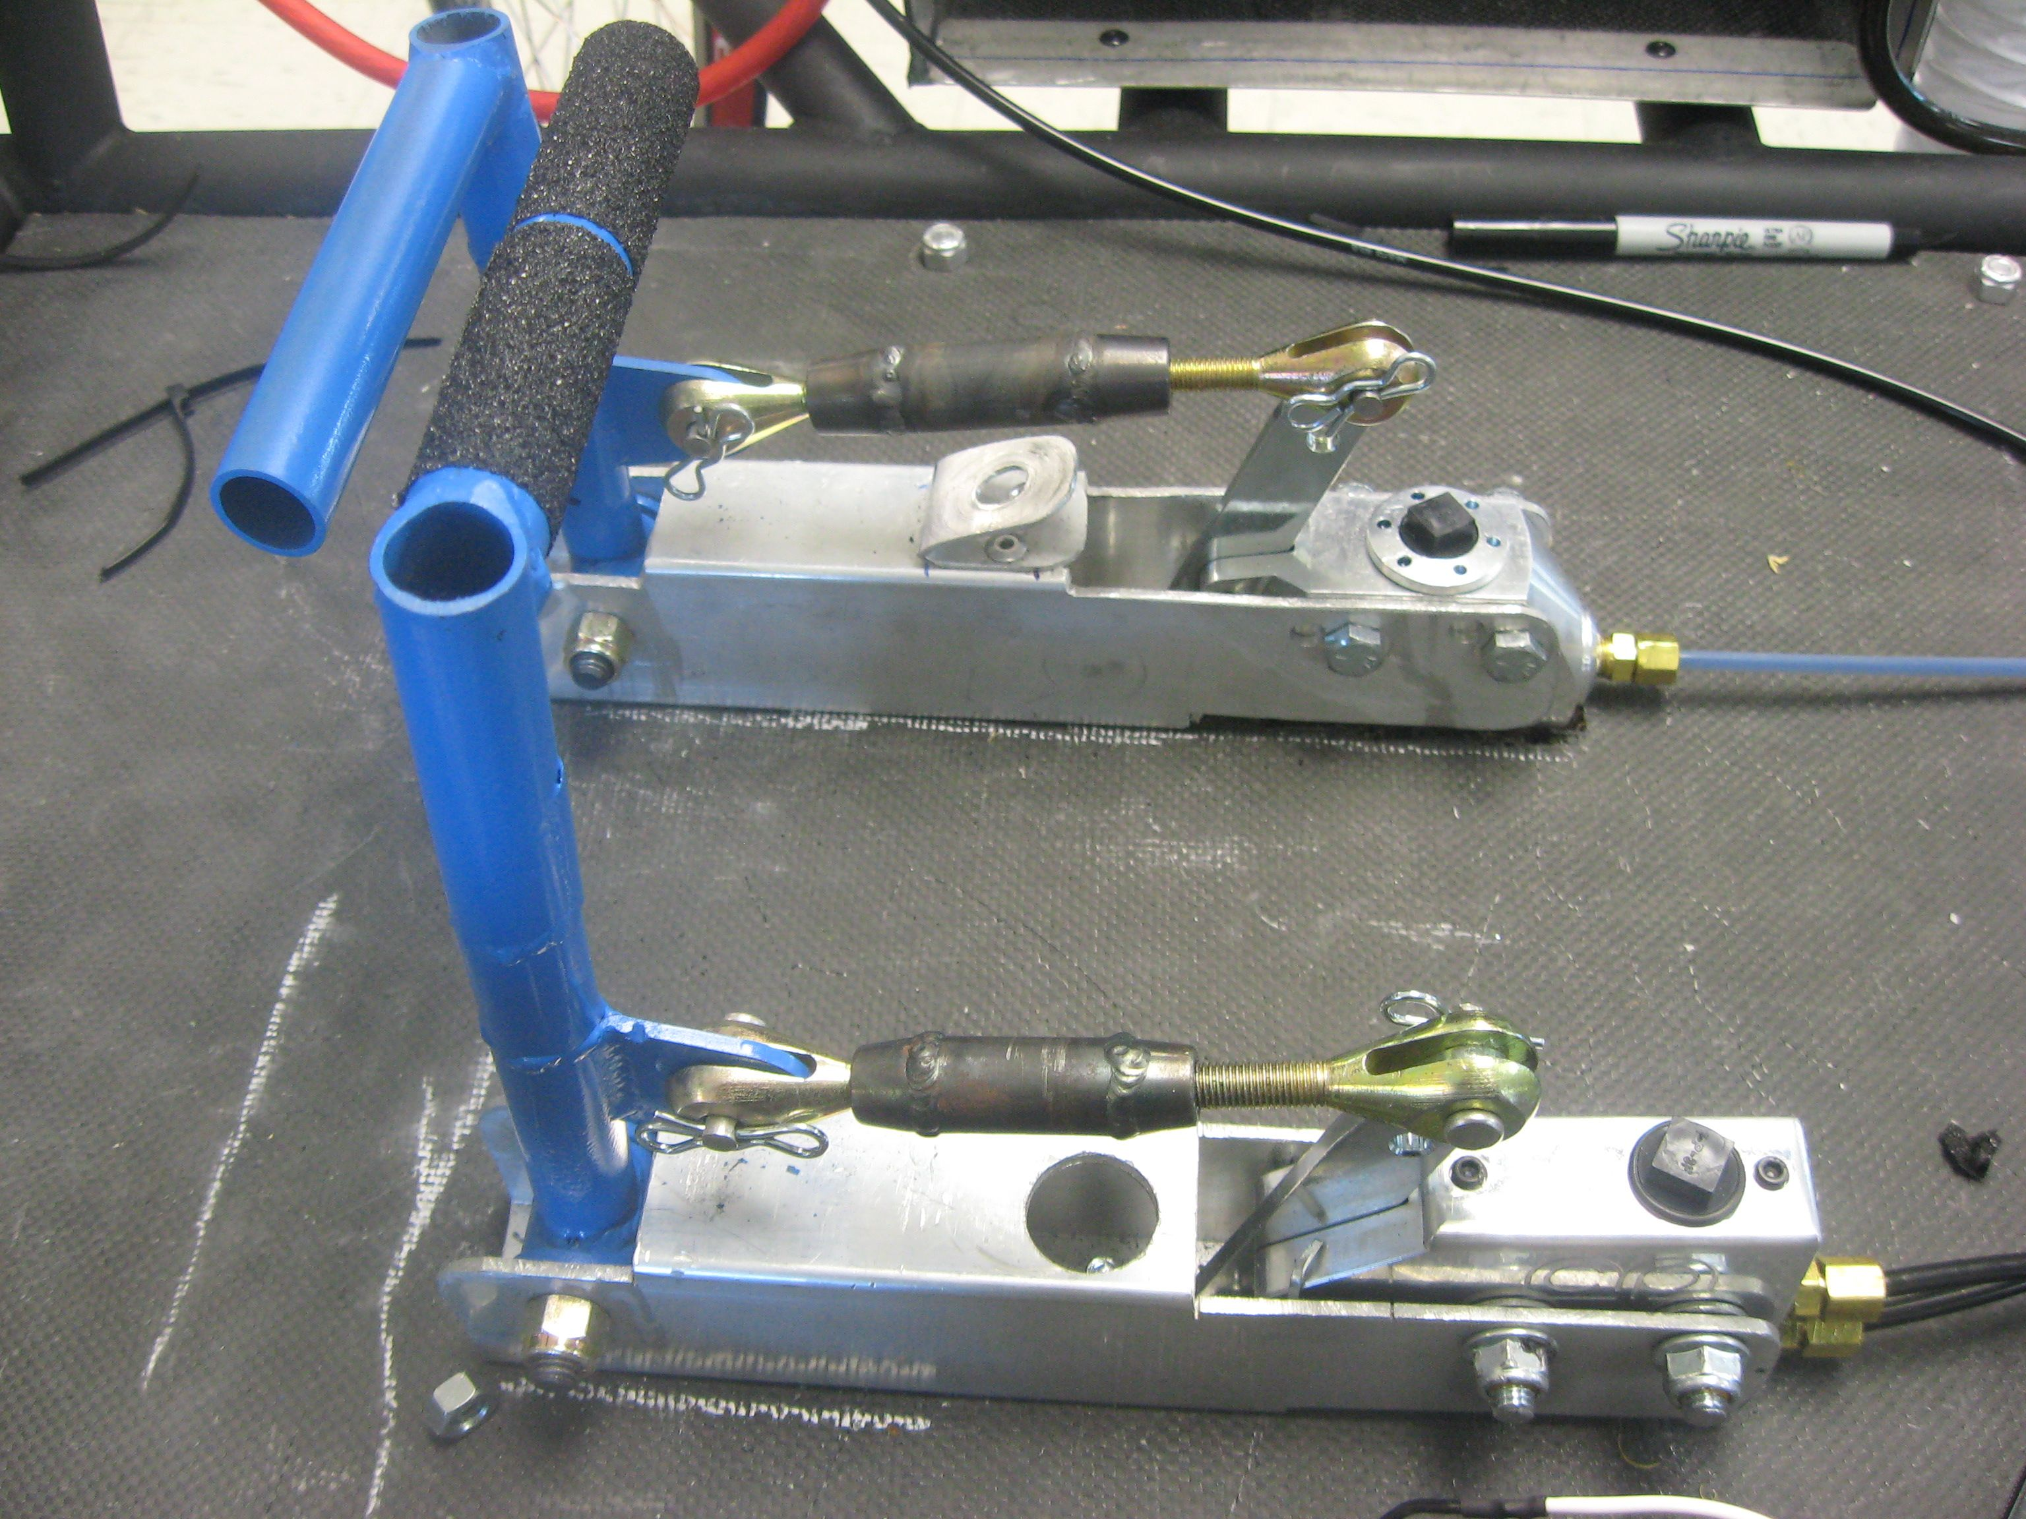
Brake Pedals
Brake pedals must also be independent
  Pedals, master cylinder, etc. separate for each system
Can no longer “link” pedals together
Must be operated by foot (no hand brakes)
Automotive style pedals must be used
X

Slide 39
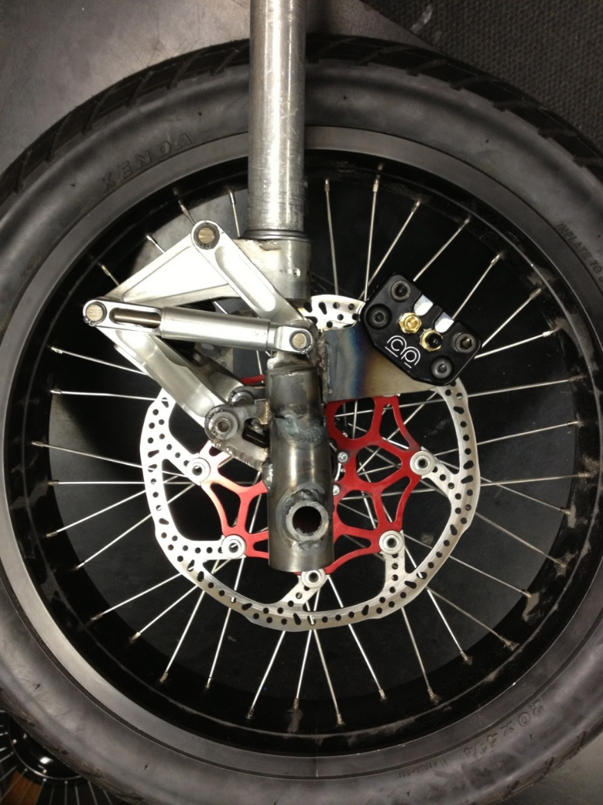
Brake Testing
Brakes are tested both statically and dynamically at the event.
  Static = Test strength of brakes at rest
  Dynamic = Test how fast brakes can stop car
Many vehicles have brake problems. Brakes must be tested before you arrive at the event!

Slide 40
Building the Vehicle Frame
Chris Jones, Chief Race Judge

